Slide 1

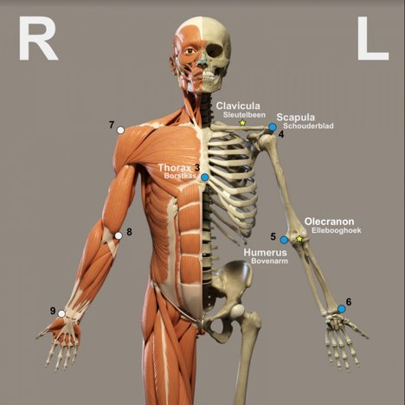

Ortho Eyes
Dr. Tony Andrioli​
Raphael, Brice, Eddie, Hassan, Arjun, Lennart

Slide 2

LUMC
2
9/27/2019

Slide 3
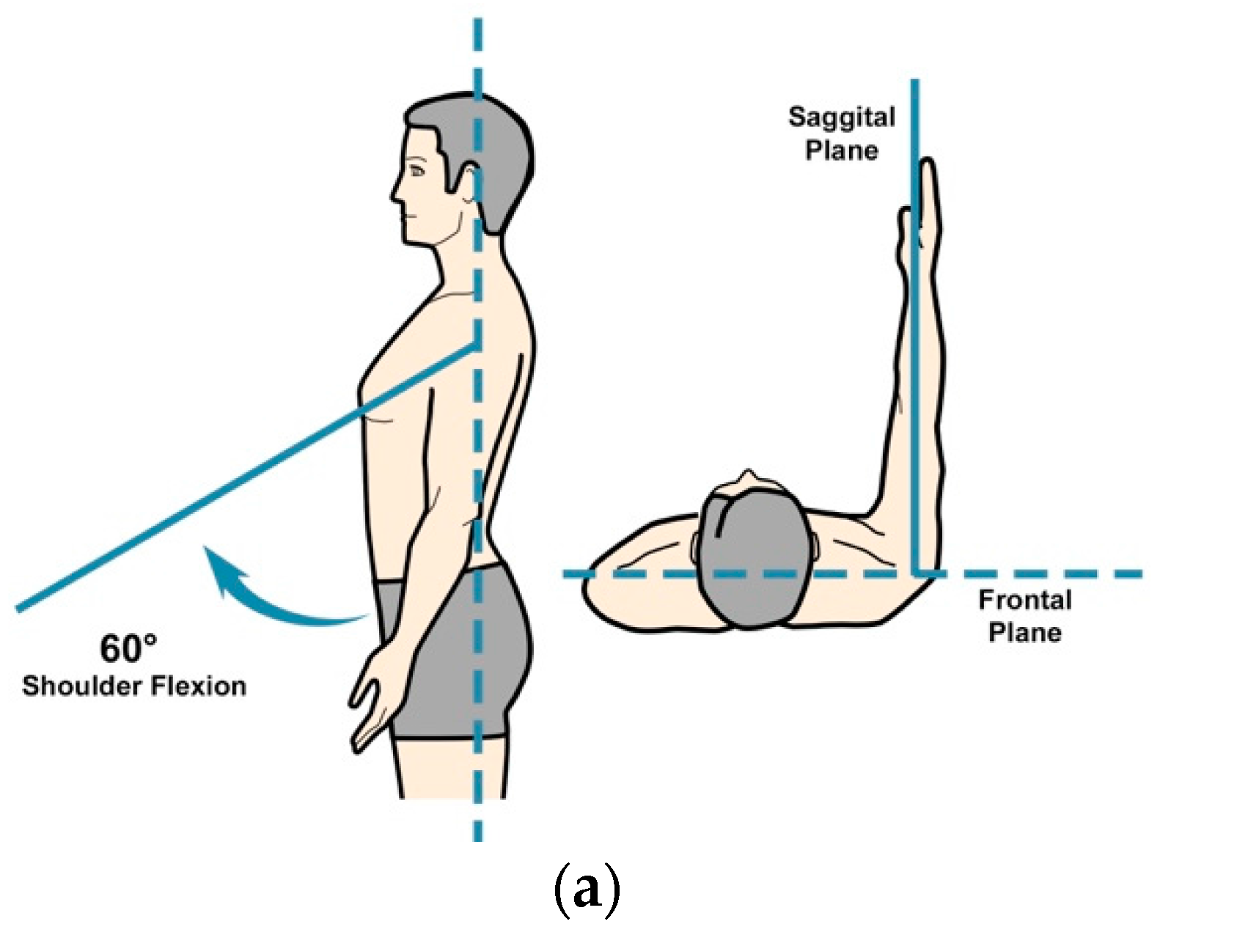


Origin of the data
Anonmyzed sensor data
Categorized in four groups
Multiple exercises
Raw Data
Converted
3
9/27/2019

Slide 4
Visualization
4
9/27/2019

Slide 5
Visualization
5
9/27/2019

Slide 6
Research Question
To what extent and way can different unsupervised data science techniques be used on kinematic recordings to contribute to a more valid and reliable diagnosis made by doctors on shoulder disabilities?
6
9/27/2019

Slide 7
Sub Question
What parameters are most valuable for the model?
Can new parameters be found?
Can new categories be found by using unsupervised learning?
Do the newly found categories make sense to a doctor?
7
9/27/2019

Slide 8
Our Approach
Reproducing the results of last group (supervised)
Wil give us insight in the recordings and parameters used.
On confirmation of the results, they can be published.
Analyse of most useful parameters from the supervised method. And think about different possibly useful parameters, like entropy
Research on relevant literature
Test different clustering techniques, with different parameter sets
What groups do the different models create for us?
8
9/27/2019

Slide 9
Questions & Suggestions
?
9
9/27/2019

